Slide 1

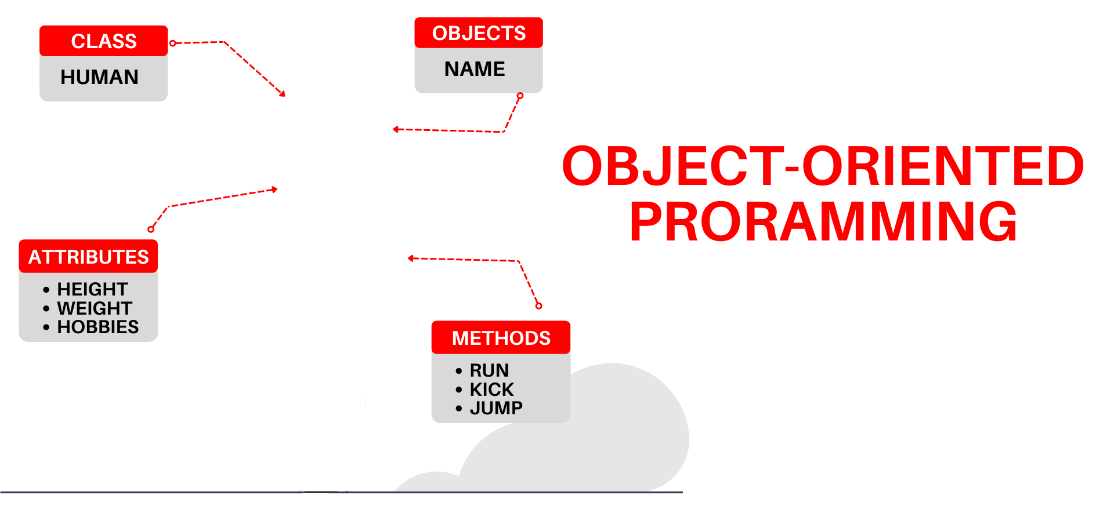

National University of Computer and Emerging Sciences
Spring 2022
Hira Naveed
Lecture # 5 Structures

Slide 2

Abstract Data Type
You have seen many primitive data types like int, float, double, bool etc.
An abstract data type (ADT) is a data type created by the programmer and is composed of one or more primitive data types.

Slide 3
Abstract Data Type
So far you’ve written programs that keep data in individual variables.
If you need to group items together, C++ allows you to create arrays.
The limitation of arrays, however, is that all the elements must be of the same data type.
Sometimes a relationship exists between items of different types of elements.

Slide 4
Abstract Data Type
Their definition statements do not make it clear that they belong together.
Variable Definition Data Held
int empNumber; Employee number
string name; Employee’s name
double hours; Hours worked
double payRate; Hourly pay rate
double grossPay; Gross pay
All these variables hold data about the same employee

Slide 5
Combining Data into Structures
Structure: is like a container that allows multiple variables to be grouped together
Variables can be of any type
  struct structName
  {
  dataType field1;
  dataType field2;
  . . .
  };

Slide 6
Example struct Declaration
  struct Student
  {
  int studentID;
  string name;
  short yearInSchool;
  double gpa;
  };
  Organize related data (variables) into a nice neat package (single unit)
structure name
structure members

Slide 7
struct Declaration Notes
Must have ; after closing }
struct names commonly begin with uppercase letter
Multiple fields of same type can be in comma-separated list:
  string name, address;

Slide 8
Creating struct Variables
struct declaration does not allocate memory or create variables
Must create a struct variable
To create variables, use structure name as type name
  Student tom;
tom
studentID
name
structure name
variable name
yearInSchool
gpa

Slide 9
Creating struct Variables
Must declare a structure before creating a structure variable
Student tom;
tom
studentID
name
structure name
yearInSchool
variable name
gpa

Slide 10
Creating struct Variables – Another way
Can also create a structure variable with its declaration
  struct Student
  { int studentID;
  string name;
  short yearInSchool;
  double gpa;
  } student1;

Slide 11
Creating struct Variables Two Ways
struct Employee
{
string firstName;
string lastName;
string address;
double salary;
int deptID;
};
Employee e1;
struct Student
{
int studentID;
string name;
short yearInSchool;
double gpa;
} s1, s2;

Slide 12
Accessing Structure Members
Use the dot (.) operator to refer to members of struct variables:
  cin >> s1.studentID;
  s1.name = “Alex Stone”;
  s1.gpa = 3.75;
Member variables can be used in any manner appropriate for their data type

Slide 13
Displaying a struct Variable
To display the contents of a struct variable, must display each field separately, using the dot operator:
  cout << s1; // won’t work
  cout << s1.studentID << endl;
  cout << s1.name << endl;
  cout << s1.yearInSchool;
  cout << " " << s1.gpa;

Slide 14
Initializing a Structure
  Values should be in the same sequence as the structure
  struct Student
  { int studentID;
  string name;
  short yearInSchool;
  double gpa;
  };
struct variable can be initialized when created
  Student s1 = {11465, "Joan", 2, 3.75};

Slide 15
Initializing a Structure
Can also be initialized member-by-member after definition:
  s1.name = "Joan";
  s1.gpa = 3.75;

Slide 16
More on Initializing a Structure
May initialize only some members:
  Student s1 = {14579};
Cannot skip over members:
// illegal
  Student s1 = {1234, "John", , 2.83};

Slide 17
More on Initializing a Structure
You can also give default values inside a struct definition
  struct Student
  {
  int studentID = 0;
  string name = ““;
  short yearInSchool = 1;
  double gpa = 1.0;
  };

Slide 18
Accessing Structure Members
struct PayRoll {
int empNumber;
string name;
double hours;
double payRate;
double grossPay;
} emp1;
void main{
emp1.empNumber = 489;
emp1.name = “Jill Smith”;
emp1.hours = 23;
emp1.payRate = 20;
emp1.grossPay = emp1.hours * emp1.payRate;
}

Slide 19
Comparing struct Variables
Cannot compare struct variables directly:
  if (s1 == s2) // won’t work
Instead, must compare on a field basis:
  if (s1.studentID == s2.studentID)

Slide 20
Assigning struct Variables
A structure variable can be assigned to another structure variable only if both are of same type
A structure variable can be initialized by assigning another structure variable to it by using the assignment operator as follows:
Student s1 = { 1432, “Zoe”, 3, 2.99} ;
Student s2 = s1;

Slide 21
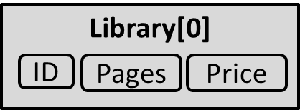
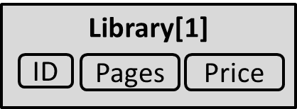
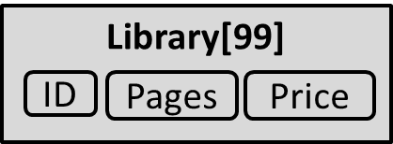
Array of Structures
An array of structures is a type of array in which each array element is a structure
struct Book
{ int ID;
int Pages;
float Price;
};
Book Library[100]; // declare array of structures
…

Slide 22
Arrays of Structures
Can be used in place of parallel arrays
const int NUM_STUDENTS = 20;
Student stuList[NUM_STUDENTS];
Individual structures in an array accessible using subscript notation
Fields within structures accessible using dot notation:
  cout << stuList[5].studentID;

Slide 23
Array of Structures
struct Book
{ int ID;
int Pages;
float Price;
};
Book b[3]; //declare of array of structures
Initializing can be at the time of declaration
Book b[3] = { {1,275,70} , {2,600,90} , {3,786,100} };
Or can be assigned values using cin:
cin >> b[0].ID;
cin >> b[0].Pages;

Slide 24
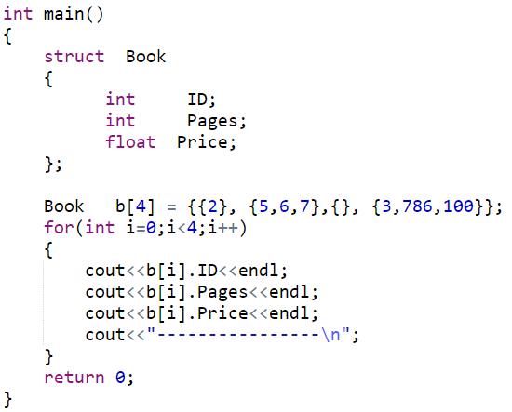
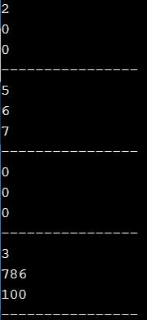
Partial Initialization of Array of Structures
Notes:
book b[5]={{2},{50,30,20.5}, {,,400}, {},{4,600, 350.8}}; // Error because of the invalid partial initialization or do like {0,0,400} or {}
Book b[5]={{},{},{}}; //correct

Slide 25
Array as Member of Structures
A structure may also contain arrays as members.
struct Student
{
int RollNo;
float Marks [3];
};
Initialization can be done at time of declaration:
Student s1 = {1, {70.0, 90.0, 97.0} };

Slide 26
Array as Member of Structures
Can also assigned values later in the program:
Student s1;
s1.RollNo = 1;
s1.Marks[0] = 70.0;
s1.Marks[1] = 90.0;
s1.Marks[2] = 97.0;
Or user can use cin to get input directly:
cin >> s1.RollNo;
cin >> s1.Marks[0];
cin >> s1.Marks[1];
cin >> s1.Marks[2];

Slide 27
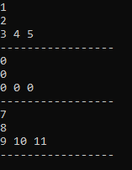
Array as Member of Structures
struct Student {
int age;
int marks;
int arr[3];
};
void main() {
Student s[3] = { 1,2,3,4,5,{},7,8,9,10,11 };
for (int i = 0; i < 3; i++) {
cout << s[i].age << endl;
cout << s[i].marks << endl;
cout << s[i].arr[0] << " " << s[i].arr[1] << " " << s[i].arr[2] << endl;;
cout<<“-----------”<<endl; }
}

Slide 28
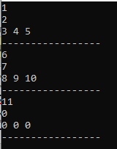
Array as Member of Structures
struct Student {
int age;
int marks;
int arr[3];
};
void main() {
Student s[3] = { 1,2,3,4,5,6,7,8,9,10,11 };
for (int i = 0; i < 3; i++) {
cout << s[i].age << endl;
cout << s[i].marks << endl;
cout << s[i].arr[0] << " " << s[i].arr[1] << " " << s[i].arr[2] << endl;;
cout<<“------------”<<endl; }
}

Slide 29
Nested Structure
A structure can be a member of another structure: called nested structure
struct A
{
int x;
double y;
};
struct B
{
char ch;
A v2;
};
B record;
record
v2
ch
x
y

Slide 30
Initializing/Assigning to a Nested Structure
void main() // Input
{
B record;
cin >> record.ch;
cin >> record.v2.x;
cin >> record.v2.y;
}
struct A{
int x;
float y;
};
struct B{
char ch;
A v2;
};
void main() //Assignment
{
B record;
record.ch = ‘S’;
record.v2.x = 100;
record.v2.y = 3.6;
}
void main() //Initialization
{
B record ={‘S’,{100, 3.6}};
}

Slide 31
Pointers to Structures
A structure variable has an address
Pointers can be used to point to structure variables.
Pointers to structures are variables that can hold the address of a structure
  Student *stuPtr;
The stuPtr pointer can point at
variables of the type Student

Slide 32
Accessing Structures with Pointers
The pointer variable should be of the type:
Your Structure
struct Rectangle {
int width;
int height;
};
void main( )
{
Rectangle rect1 = {22,33};
Rectangle* rect1Ptr = &rect1;
}

Slide 33
Accessing Structures with Pointers
How to access the structure members (using pointer)?
  Use dereferencing operator (*) with dot operator (.)
struct Rectangle {
int width;
int height;
};
void main( )
{
Rectangle rect1 = {22,33};
Rectangle* rect1Ptr = &rect1;
cout<<(*rectPtr1).width << endl;
cout<<(*rectPtr1).height << endl;
}

Slide 34
Accessing Structures with Pointers
Is there some easier way to do this?
  Use arrow operator ( -> ) instead of * and .
struct Rectangle {
int width;
int height;
};
void main( )
{
Rectangle rect1 = {22,33};
Rectangle* rect1Ptr = &rect1;
cout<< rectPtr1->width << endl;
cout<< rectPtr1->height << endl;
}

Slide 35
Pointer as Structure Member
Pointers can also be a member of a structure
struct Rectangle {
int *width;
int height;
};
void main( )
{ int w = 3;
Rectangle rect1 = {&w,5}
*rect1.width = 2;
rect1.height = 4;
}

Slide 36
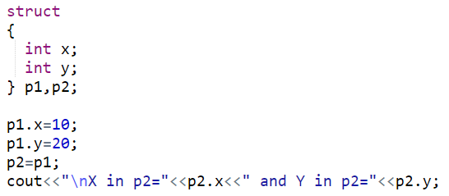
Anonymous Structure
Structures can be anonymous
Must create variable after declaration
Notes:
Anonymous structure definition must have a structure type variable.

Slide 37
Other Stuff You Can Do With a struct
You can also associate functions with a structure (called member functions)

Slide 38
Quick Example
struct StudentRecord {
string name; // student name
int marks[5]; // test grades
double ave; // final average
void print_ave( ) {
cout << "Name: " << name << endl;
cout << "Average: " << ave << endl;
}
};

Slide 39
Using a Member Function
Use the dot operator to call member functions of a struct
StudentRecord stu;
stu.print_ave( );

Slide 40
Structures as Function Arguments
May pass members of struct variables to functions:
  //function definition
  float computeGPA(float gpa){
  ……………
  }
  //function call
  computeGPA(s1.gpa);

Slide 41
Structures as Function Arguments
May pass entire struct variables to functions
  Pass-by-value
  Pass-by-reference
  Pass-using pointers

Slide 42
Structures as Function Arguments – Pass by Value
A copy of the struct box is created and saved in the function parameter r
struct Rectangle {
double length;
double width;
double area;
};
void changeRect(Rectangle r) {
r.length = 5;
r.width = 6;
r.area = 30;
}
void main(){
Rectangle box = {1, 2, 2};
changeRect(box); }

Slide 43
Structures as Function Arguments – Pass by Value
void changeRect(Rectangle r) {
r.length = 5;
r.width = 6;
r.area = 30;
}
void main(){
Rectangle box = {1, 2, 2};
changeRect(box);
cout << box.length << endl; prints 1
cout << box.width << endl; prints 2
cout << box.area << endl; prints 2
}

Slide 44
Structures as Function Arguments – Pass by Reference
The actual struct variable box is passed by reference (parameter r is just another name for box)
struct Rectangle {
double length;
double width;
double area;
};
void changeRect(Rectangle &r) {
r.length = 5;
r.width = 6;
r.area = 30;
}
Rectangle box = {1, 2, 2};
changeRect(box);

Slide 45
Structures as Function Arguments – Pass by Value
void changeRect(Rectangle &r) {
r.length = 5;
r.width = 6;
r.area = 30;
}
void main(){
Rectangle box = {1, 2, 2};
changeRect(box);
cout << box.length << endl; prints 5
cout << box.width << endl; prints 6
cout << box.area << endl; prints 30
}

Slide 46
Structures as Function Arguments - Notes
Passing a structure to a function by value can slow down a program, waste space
Passing a structure to a function by reference will speed up program, but the function may change data in structure
Using a const reference parameter allows read-only access to reference parameter, it is fast and does not waste space

Slide 47
Structures as Function Arguments – Pass by const Reference
void changeRect(const Rectangle &r) {
r.length = 5;//ERROR! Cannot modify const
r.width = 6; //ERROR! Cannot modify const
r.area = 30; //ERROR! Cannot modify const
}
void main(){
Rectangle box = {1, 2, 2};
changeRect(box);
}

Slide 48
Structures as Function Arguments – Pass by const Reference
void showRect(const Rectangle &r) {
cout << r.length << endl;
cout << r.width << endl;
cout << r.area << endl;
}
void main(){
Rectangle box = {1, 2, 2};
showRect(box);
}
Output: 1
2
2

Slide 49
Returning a Structure from a Function
A Function can return a struct:
  Student getStudentData(); // prototype
  stu1 = getStudentData(); // call
Function must define a local structure variable
  for internal use
  for use with return statement

Slide 50
Returning a Structure from a Function - Example
  Student getStudentData()
  {
  Student tempStu;
  cin >> tempStu.studentID;
  cin >> tempStu.yearInSchool;
  cin >> tempStu.gpa;
  return tempStu;
  }

Slide 51
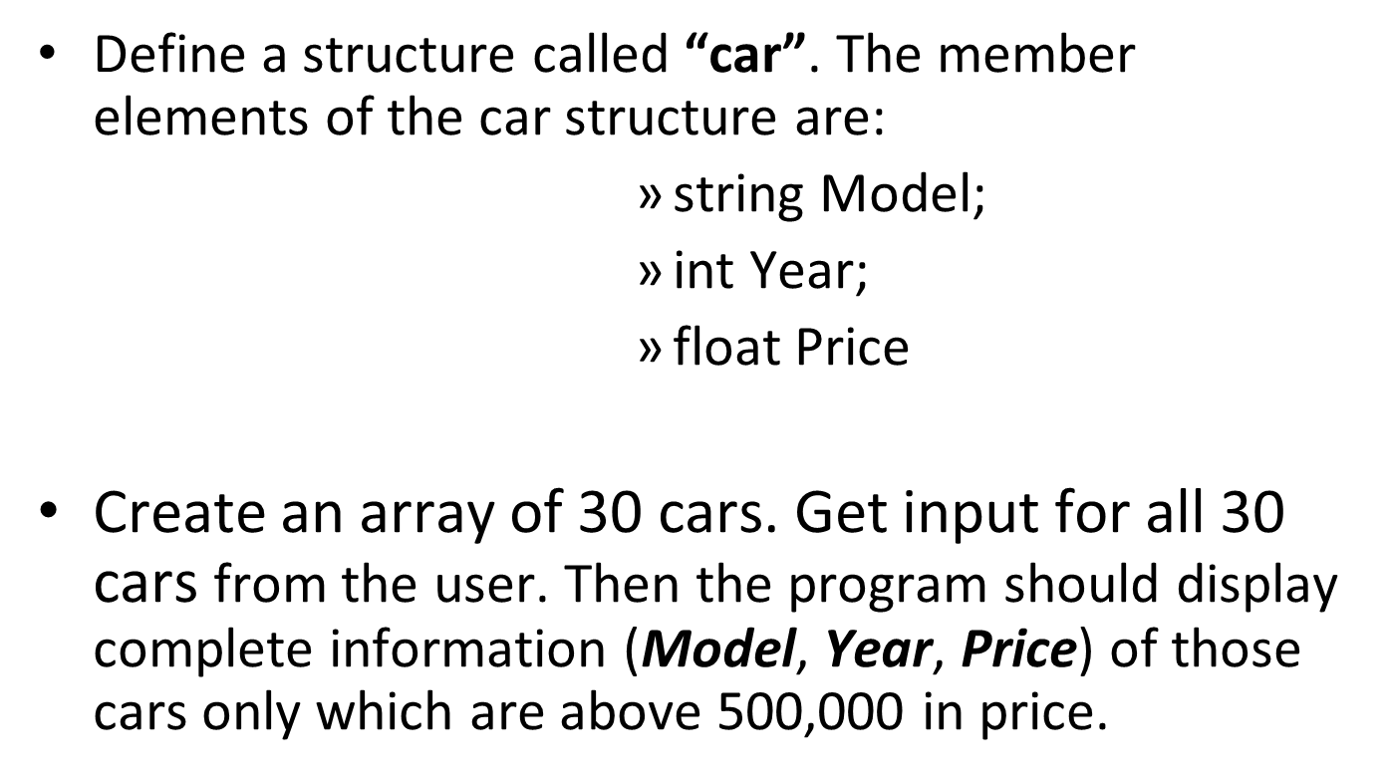
Practice Question 1

Slide 52
Practice Question 1
struct Car {
string model;
int year;
float price;
};
void main() {
Car showroom[30]; //array of cars
for (int i = 0; i < 30; i++) {
cin >> showroom[i].model;
cin >> showroom[i].year;
cin >> showroom[i].price;
}
for (int i = 0; i < 30; i++) {
if (showroom[i].price > 500000) {
cout << showroom[i].model<<" "<< showroom[i].year <<" " <<showroom[i].price;
}
}
}

Slide 53
Practice Question 2
Write a program that implements the following using C++ struct. The program should finally displays contactInfo values for 10 people.
ContactInfo
Name
PhoneNo
Address
City
Country

Slide 54
Practice Question 2
struct Address {
string city;
string country; };
struct ContactInfo {
string name;
long int number;
Address address; };
void main() {
ContactInfo phonebook[10];
for (int i = 0; i < 10; i++) {
cin >> phonebook[i].name;
cin >> phonebook[i].number;
cin >> phonebook[i].address.city;
cin >> phonebook[i].address.country;
}
for (int i = 0; i < 30; i++) {
cout << phonebook[i].name << " " << phonebook[i].number << " "
<< phonebook[i].address.city << " " << phonebook[i].address.country
<< endl;;
} }

